Slide 1
Bayesian Networks
Rosemary Hartman
8/12/2021
Data Science PWT
https://github.com/InteragencyEcologicalProgram/DataScience/tree/master/2021.08.12

Slide 2
What is Bayesian network analysis?
Probabalistic graphical model
Diagram of how multiple variables interact
Allow you to calculate probability of one situation given all other variables.
No “outcome”

Slide 3
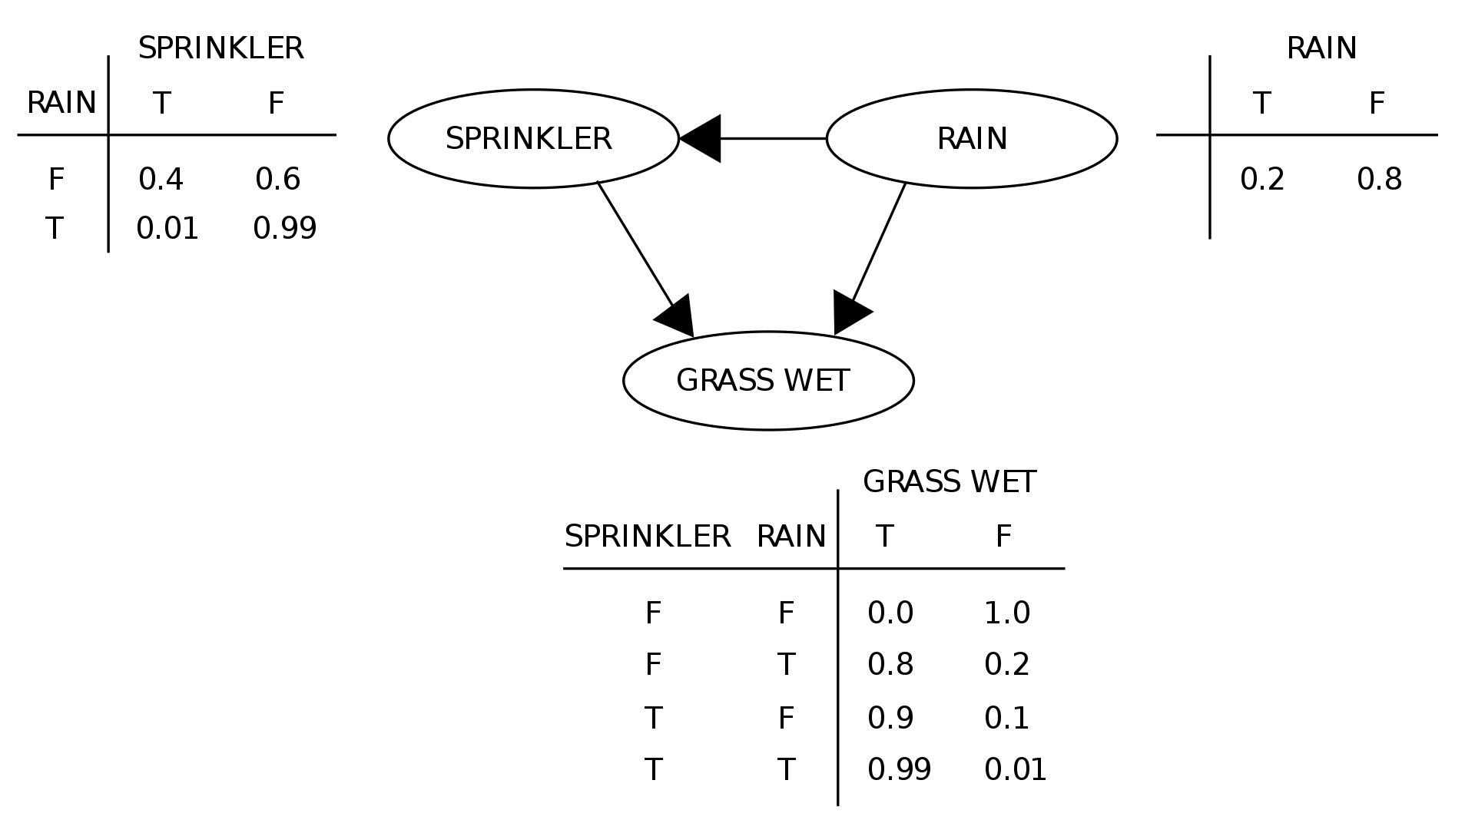
From wikipedia

Slide 4
Turn your conceptual model into a real model!

Slide 5
Network Diagram – Long-term trends- 1980-2010 (or so)
Tier 4 – Delta Smelt Responses
Tier 3 – Habitat Attributes
Tier 2 – Environmental Drivers
Population Growth
Delta Smelt Range/distributions
Fall X2
Predation risk
Water Temperature
Zooplankton BPUE
Predator populations
Turbidity
Phytoplankton biomass
Fall outflow
Spring outflow
Notes:
If we are going to use this, we need measurements for most of it, unless they are latent variables.
Compare results of a time series from the past few years versus longer time series. Could maybe use another proxy in the more recent period.

Slide 6
Demonstration – Fall Smelt Habitat
Inputs
FMWT index
Low Salinity Zone (LSZ) temperature
LSZ Secchi Depth
Delta Outflow
Zooplankton biomass
Chlorophyll Biomass
Packages:
Bnlearn
networkD3
Heatmaply
visNetwork

